Slide 1

Carrigmore Park Part 8
Planning & Projects | Public Realm

Slide 2
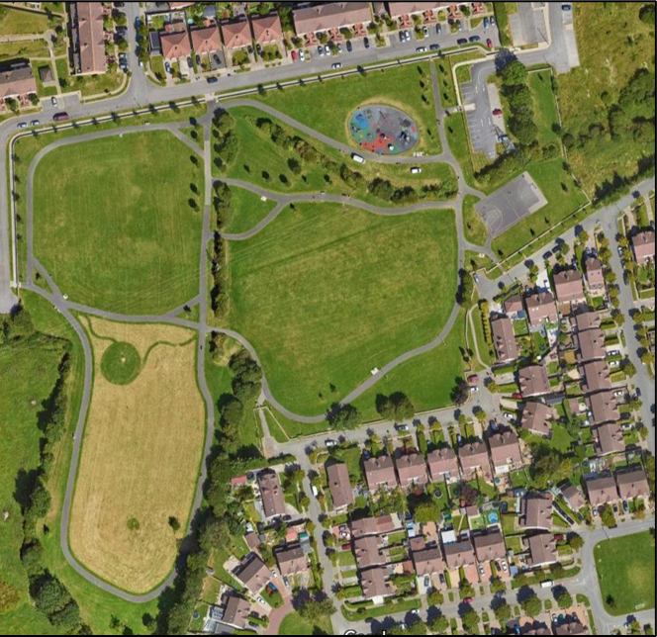
Context of Project & Location
Carrigmore park (approx. 4.2 hectares) is located within the townland of Fortunestown. The park borders two housing estates and its southern end feeds into a series of fields that extend to the Dublin mountains, adding ecological and amenity value.
The focus of this upgrade is to create a new space that reflects and caters to the needs of the surrounding community. The goal is to create a safe and welcoming environment for the community, free from anti-social behaviour and open for all ages to meet, exercise and enjoy nature. The proposed upgrade also aims to further amplify the natural dimensions of the park through the provision of tree planting and rewilding areas. This builds upon the park’s connection with the county’s wider green infrastructure network as outlined in the County’s Development Plan.

Slide 3
The Carrigmore Park Upgrade Will Consist Of:
Part 8 Upgrades:
Physical and Mental Health
Provision of a pump track, calisthenics area, and an active age area.
Upgrading of existing footpaths, to involve the provision a new footpath and the realignment of an existing footpath.
Bringing the existing soccer pitch area into use, to involve installation of goal posts.
The provision of a new sports pitch area (65m x 40m).
Provision of a small bridge, providing access across hedgerow.
Retaining existing entrances and upgrading where required. Provision of 2 new pedestrian entrances and a new entranced plaza.
Healthy Environment
Retention and replanting of existing hedgerows and trees.
Provision of 2 wetland attenuation areas.
Creation of a mini woodland and rewilding areas for enhanced biodiversity.

Slide 4
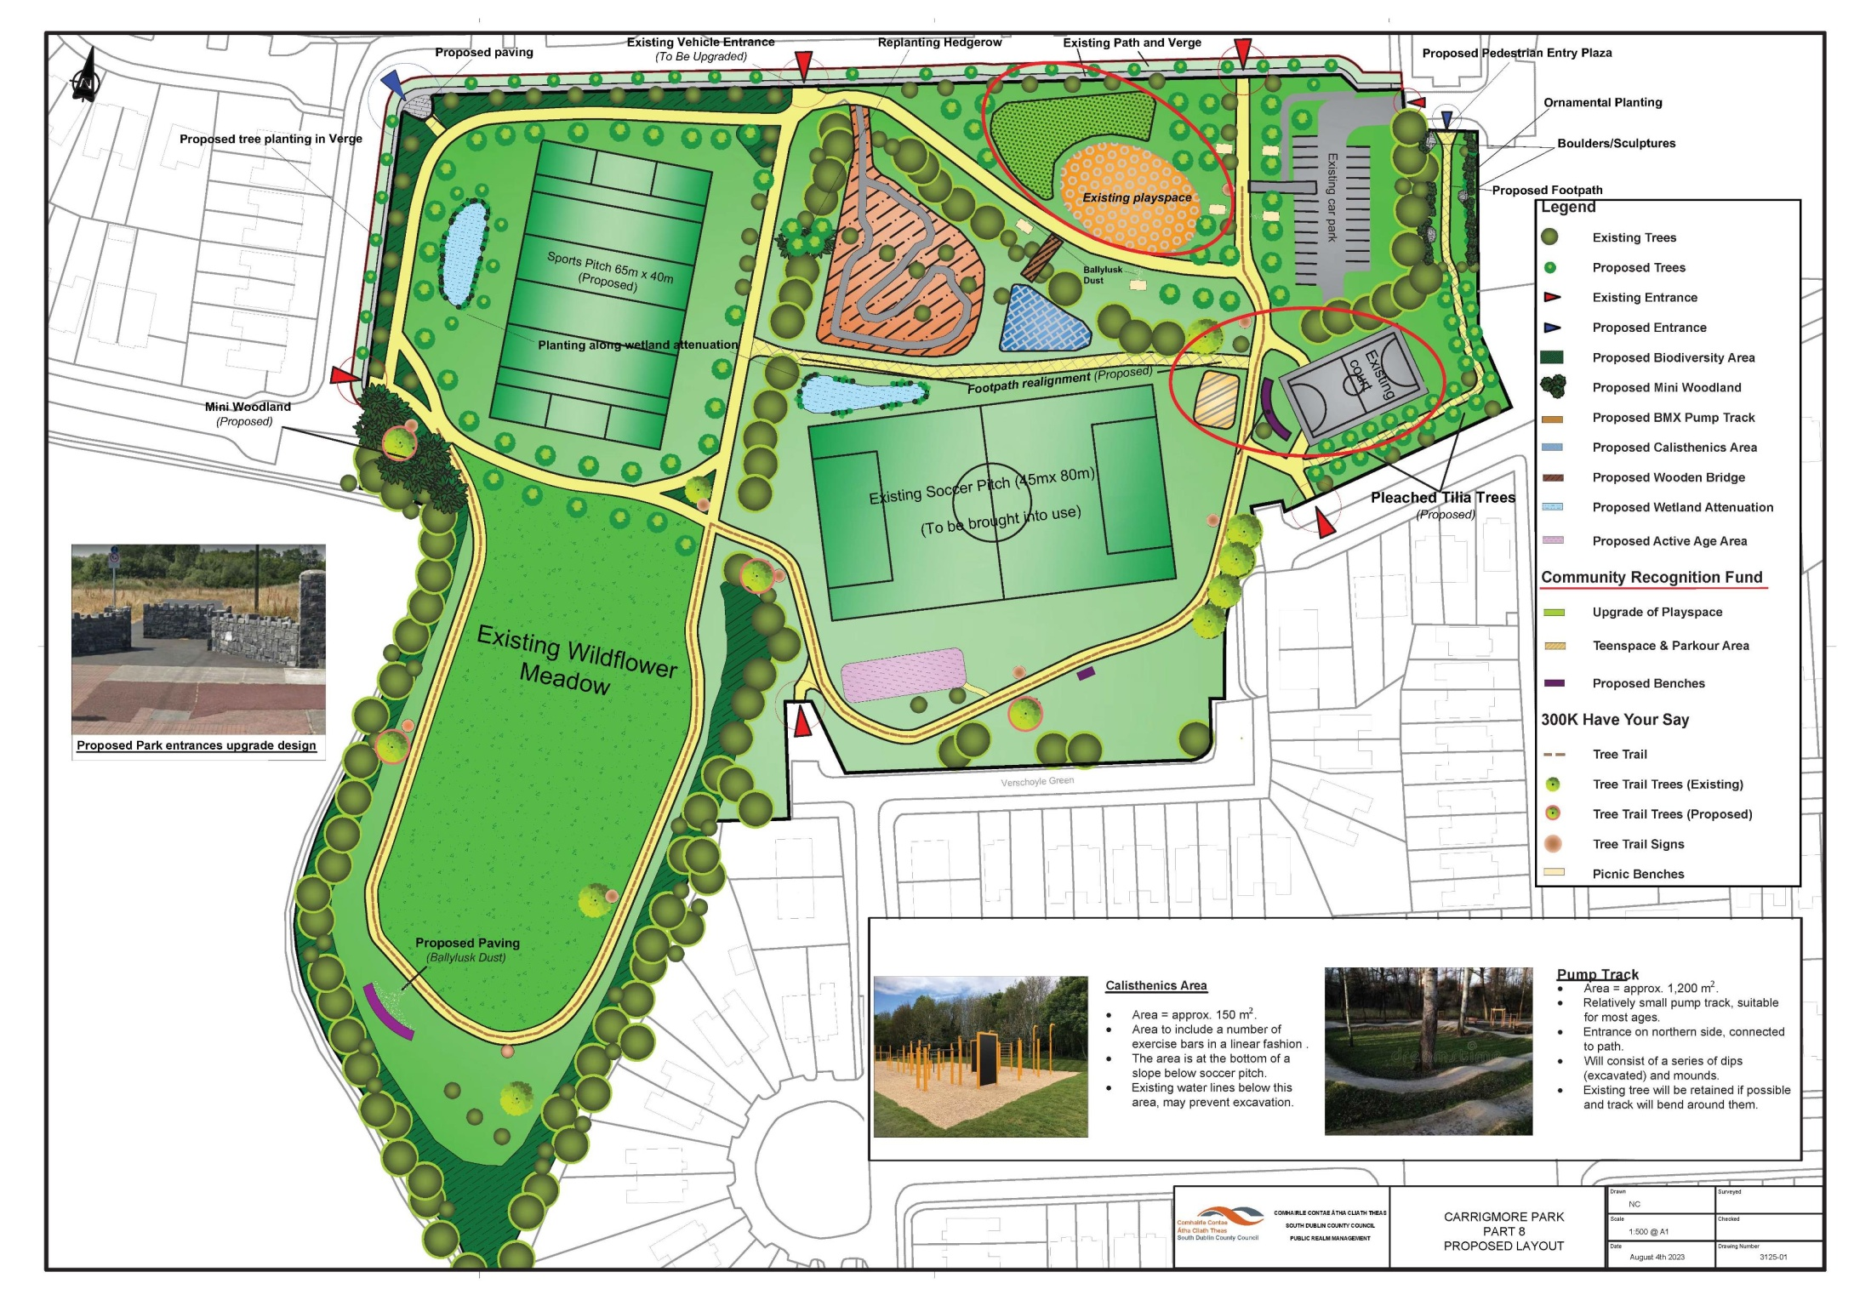
Part 8 Masterplan

Slide 5
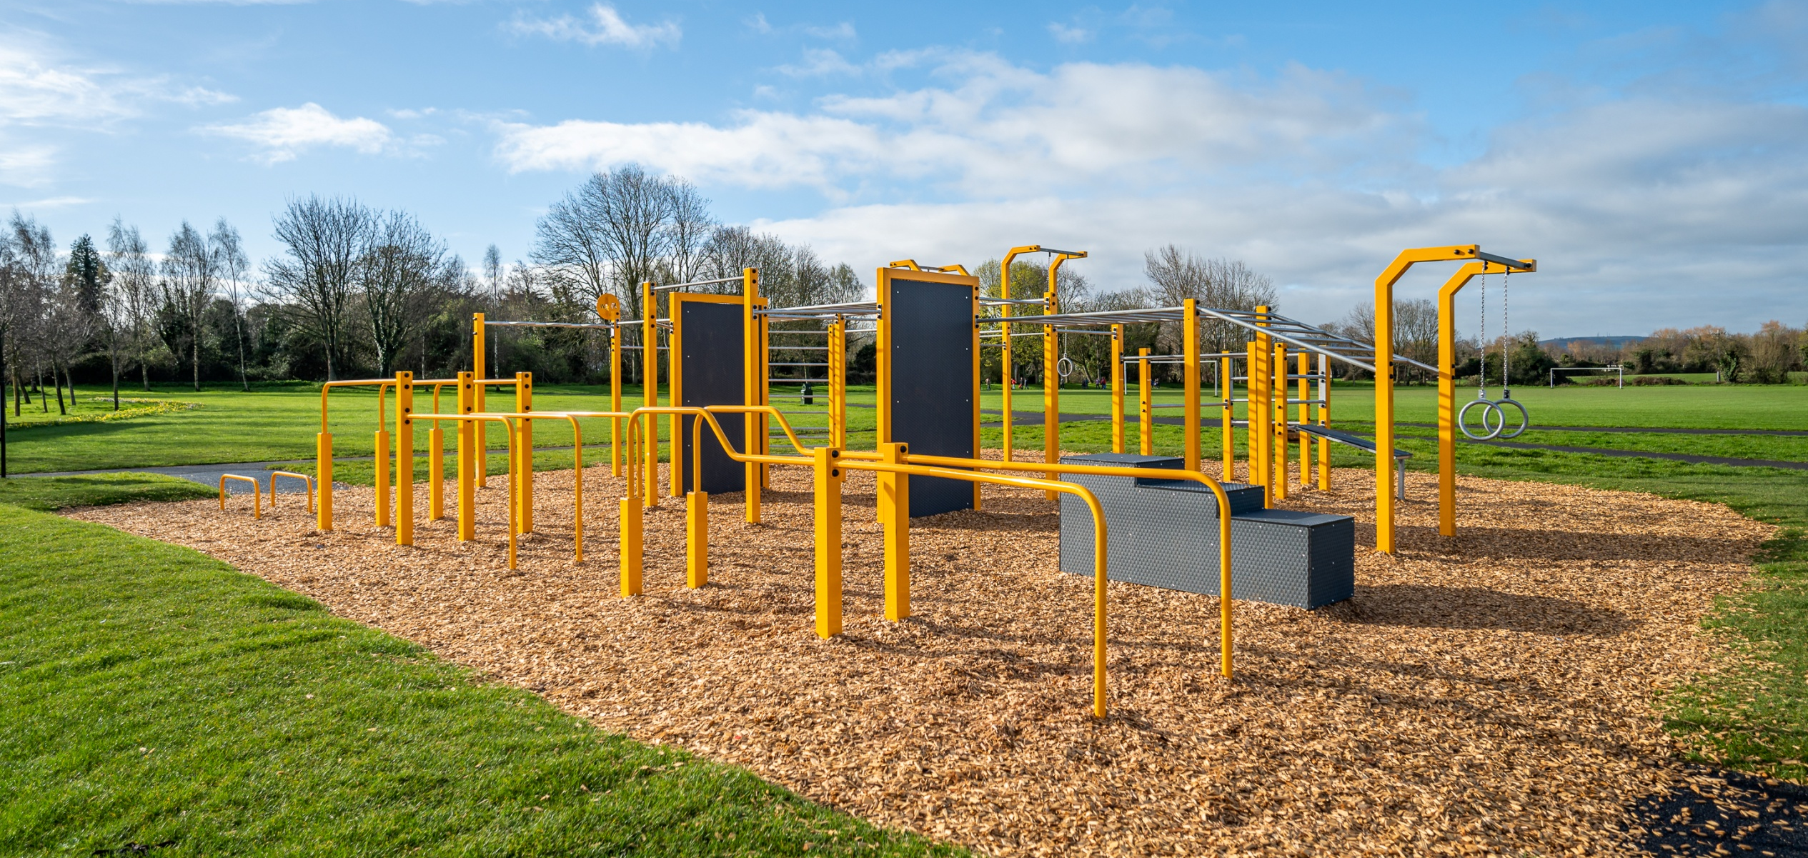

Slide 6
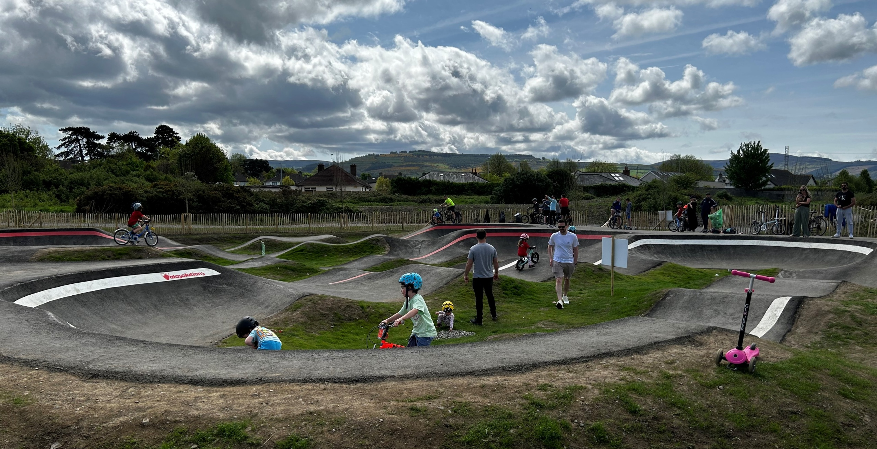

Slide 7
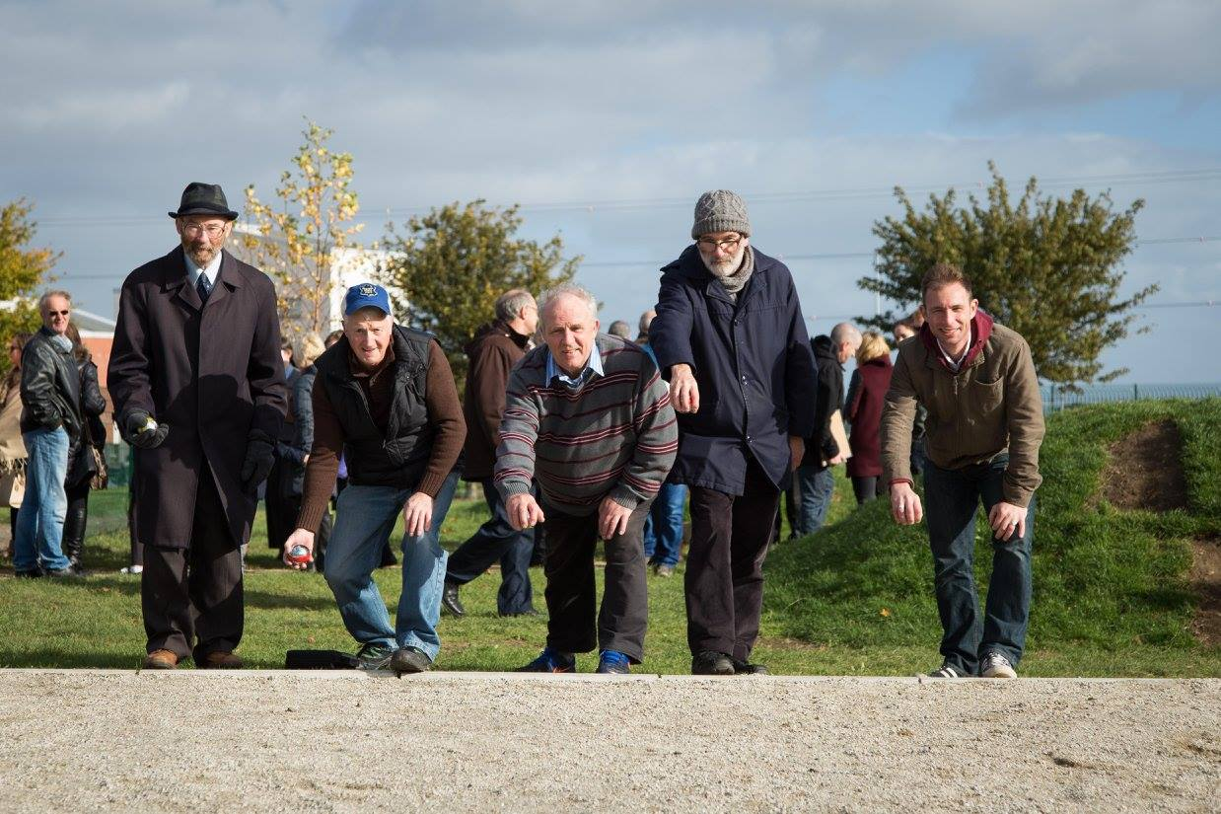
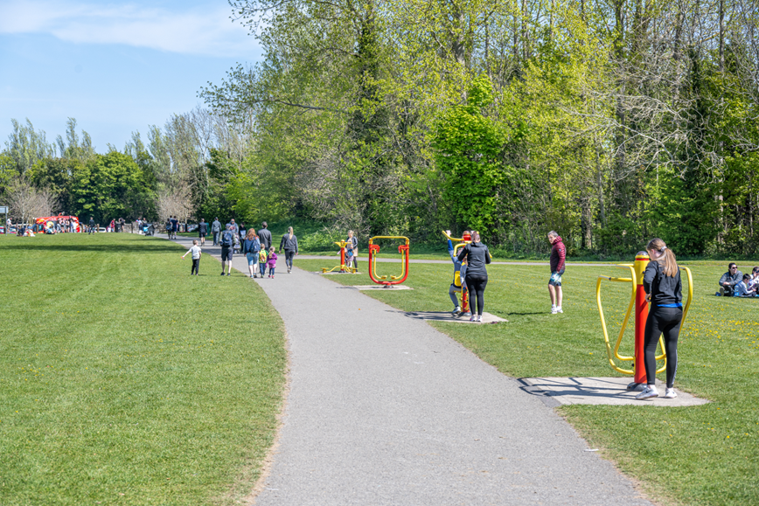
Active Age Facilities

Slide 8
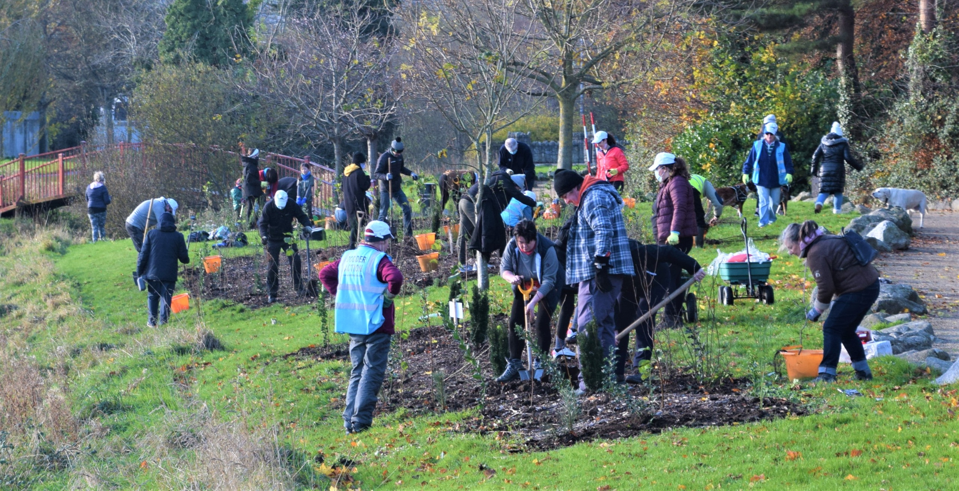
Biodiversity Improvements

Slide 9
